Slide 1
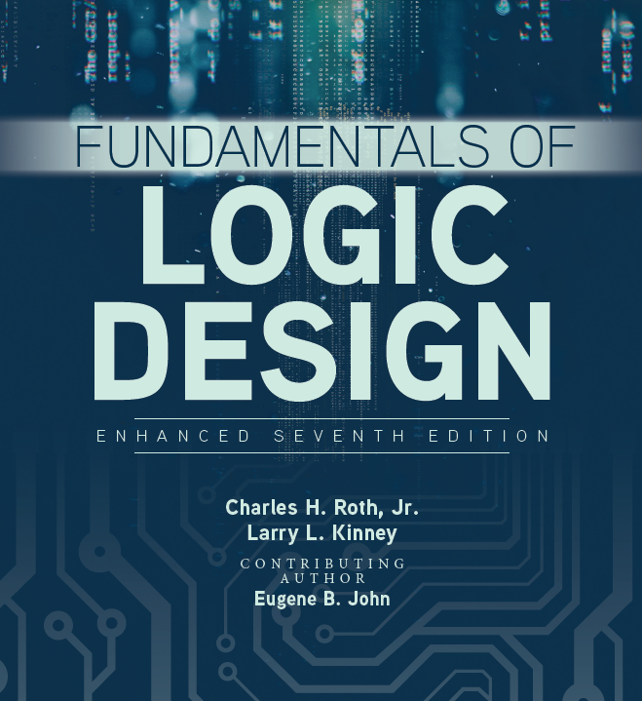

Unit 11(II)
Latches and Flip-Flops

Slide 2
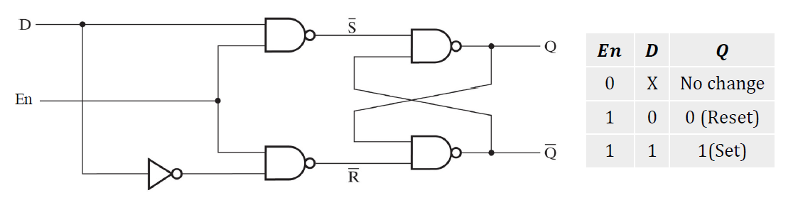
D latch
Q
Q’
The indeterminate condition in the SR latch when 𝑬n=𝟏, 𝑺=𝟏, and 𝑹=𝟏 can be eliminated by ensuring that inputs 𝑺 and 𝑹 are never equal to 1 at the same time

Slide 3
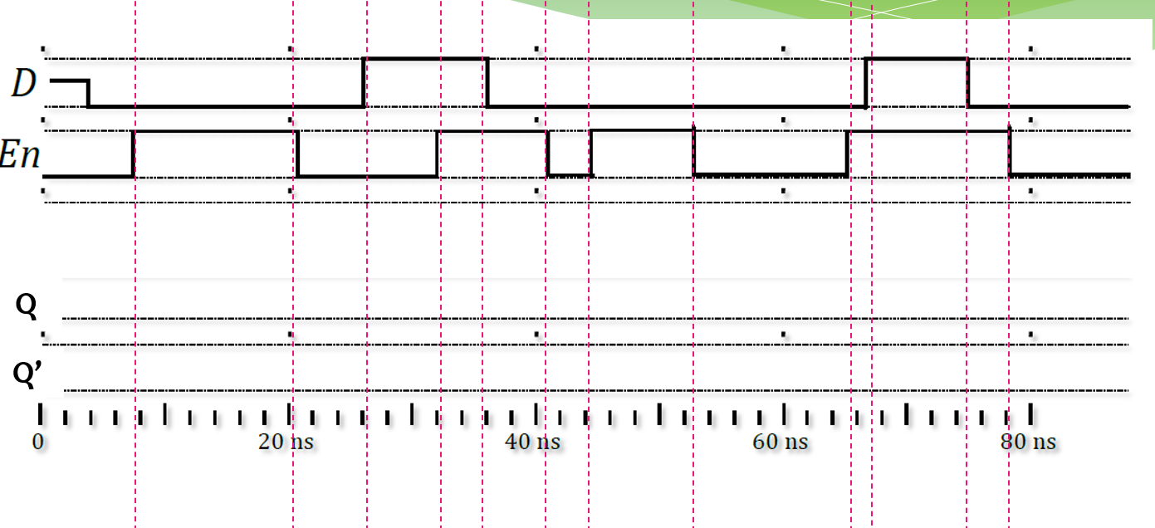
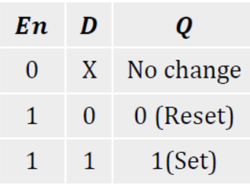

Slide 4
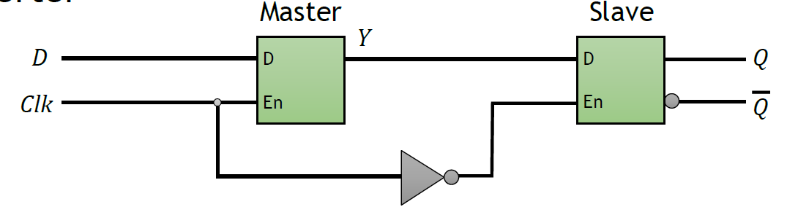
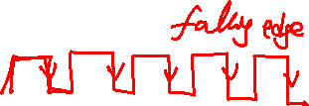
Edge-triggered D flip-flop
When clk = 1, the master D latch will be enabled while the slave D latch is disabled, Y=D
When clk = 0, the master D latch is disabled while the slave D latch is enabled, Q=D
This output remains unchanged until the clock transitions from 1 to 0, i.e. it is falling-edge triggered

Slide 5
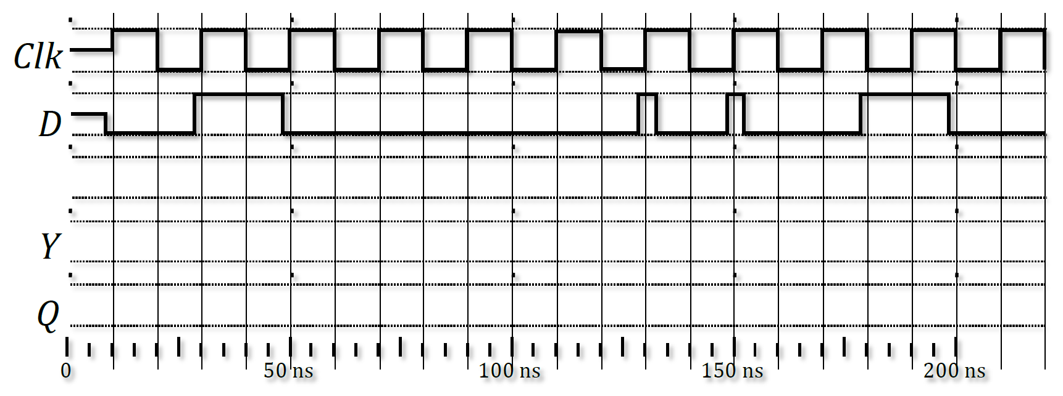
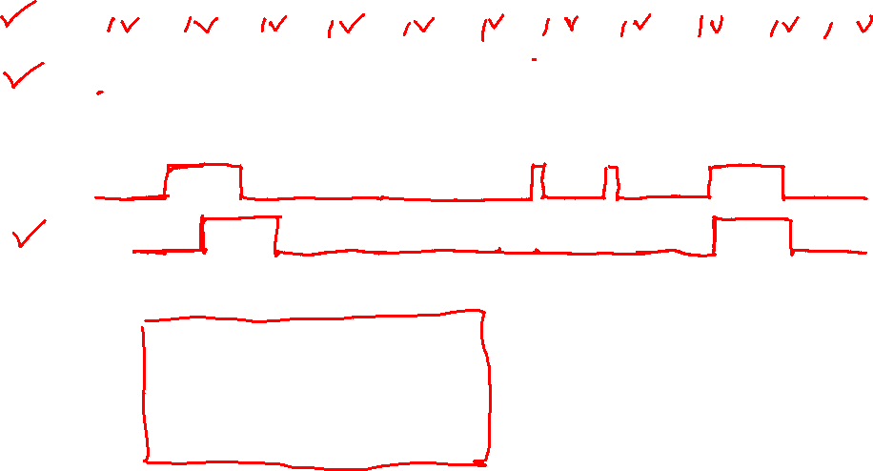
Falling-edge-triggered D flip-flop

Slide 6
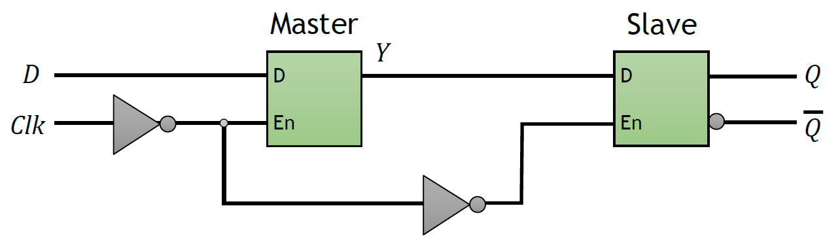
Edge-triggered D flip-flop
When clk = 0, the master D latch will be enabled while the slave D latch is disabled, Y=D
When clk = 1, the master D latch is disabled while the slave D latch is enabled, Q=D
This output remains unchanged until the clock transitions from 0 to 1, i.e. it is positive-edge triggered

Slide 7
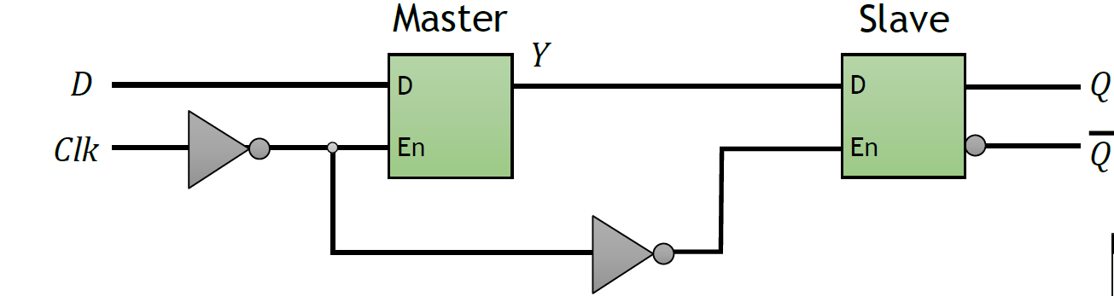
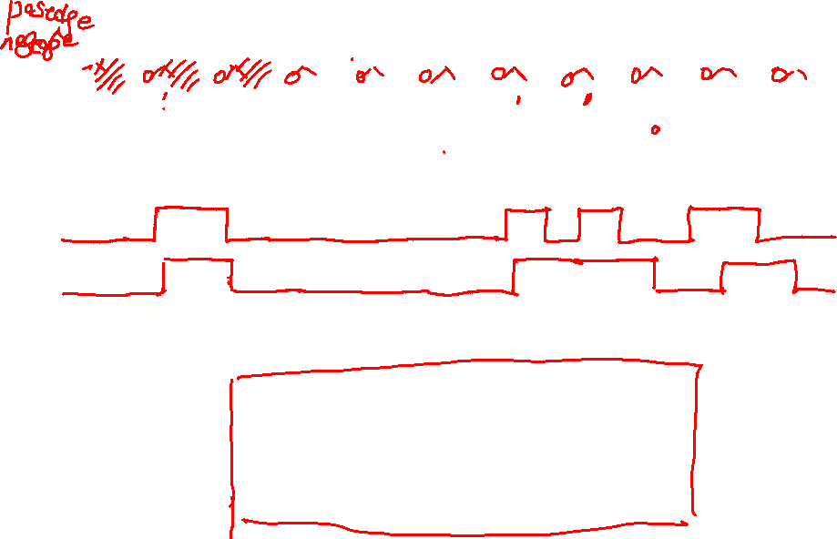
Rising-edge-triggered D flip-flop

Slide 8
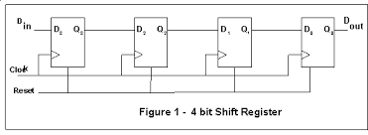
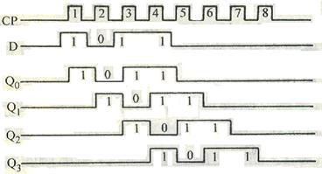
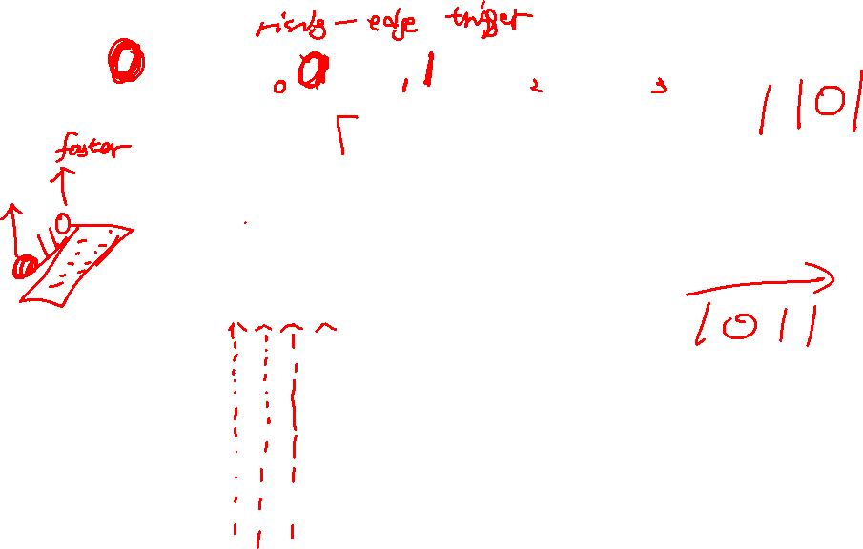

Slide 9
